Slide 1
Competitive Rate Prediction
Luxury Hotel Nightly Room Prices
A time series project
Nicole Young

Slide 2
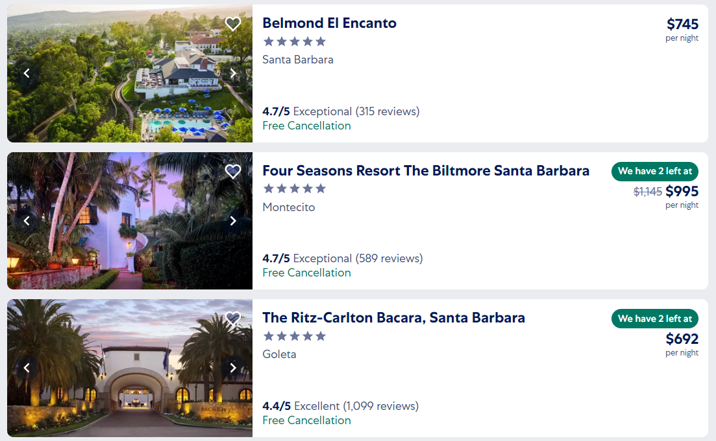

Slide 3
Objective:
Develop supplemental assistive analytics
Construct a method for predicting upcoming rate adjustments by commercial competitors using programmatic pricing in Luxury Hotels whereby enhancing the competitive advantage of a subject hotel’s pricing & distribution timing strategy.

Slide 4
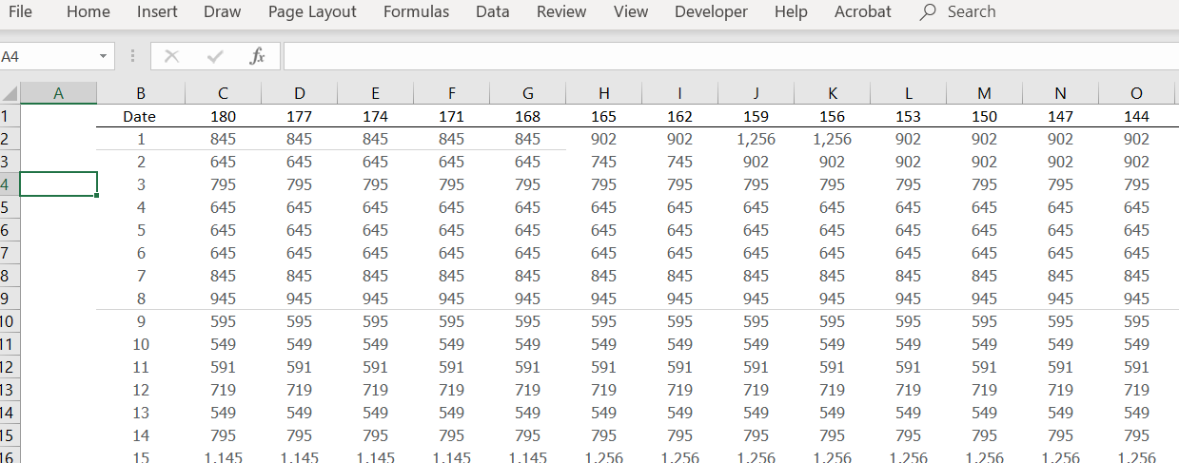
View of source data

Slide 5
Considerations:
Start simple but accurate
Depth of pricing matrix
Helpful variables
Time & Tracking
Method & Replication

Slide 6
Conclusion
Current Model accuracy rate: 61% - not there yet
Needs to go in an AWS environment
Model is aggressive – raises pricing 83% of dates
Weighting to preference most recent trends
Need a solid method on outlier data (it is significant)

Slide 7
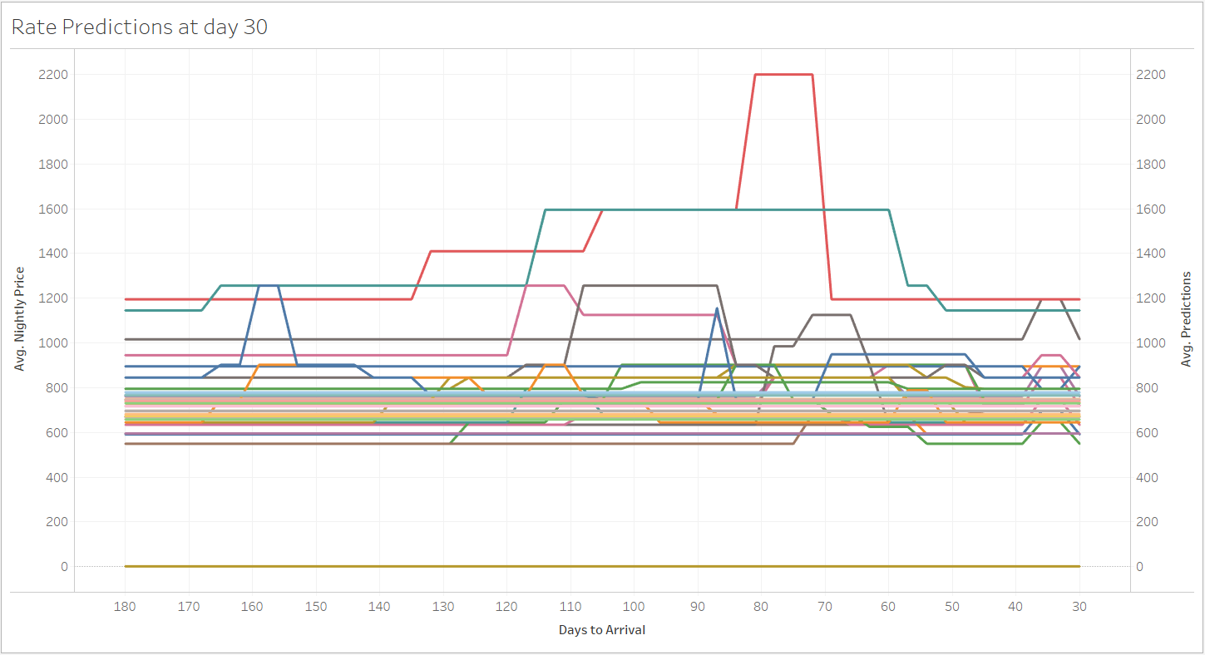

Slide 8
Where to go Next:
Allow data & actuals to accumulate & inform model
Introduce variables one at a time
Lags, Prior Periods, Day of week
Test multiple model concept
Test frequency
Introduce pricing complexities

